Slide 1
Data Communications for a Global Environment
Lecture 19

Slide 2
Chapter 11
Network Security

Slide 3
Why Networks Need Security
Data Communications for a Global Environment
Organizations vulnerable due to dependency on computing and widely available Internet access to its computers and networks
Business loss potential due to security breaches
$350,000 average loss per incident
Reduced consumer confidence as a result of publicity
Loss of income if systems offline
Costs associated with strong laws against unauthorized disclosures (California: $250K for each such incident)
Compliance with HIPPA and Sorbanes-Oxley
Protecting organizations’ data and application software
Value of data and applications far exceeds cost of networks
Firms may spend about $1,250/employee on network security

Slide 4
Financial Impact of Security
Data Communications for a Global Environment
2005 Computer Security Institute/FBI Computer Crime and Security Survey
70% of the respondents reported security breaches in the last 12 months
60% reported a financial loss due to security breaches
Average loss: $350,000
Security issues can impact consumer confidence
70% of all email sent worldwide was spam in 2006
New laws on data privacy and financial information include Sarbanes-Oxley Act (SOX) and Health Insurance Portability and Accountability Act (HIPPA)

Slide 5
Primary Goals in Providing Security: “CIA”
Data Communications for a Global Environment
Confidentiality
Protection of data from unauthorized disclosure of customers and proprietary data
Integrity
Assurance that data have not been altered or destroyed
Availability
Providing continuous operations of hardware and software so that parties involved can be assured of uninterrupted service

Slide 6
Types of Security Threats
Data Communications for a Global Environment
Business continuity planning related threats
Disruptions
Loss or reduction in network service
Could be minor or temporary (a circuit failure)
Destructions of data
Viruses destroying files, crash of hard disk
Disasters (Natural or manmade disasters )
May destroy host computers or sections of network
Intrusion
Hackers gaining access to data files and resources
Most unauthorized access incidents involve employees
Results: Industrial spying; fraud by changing data, etc.

Slide 7
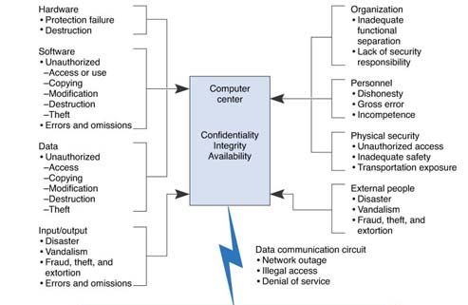
Threats to a computer center
Data Communications for a Global Environment

Slide 8
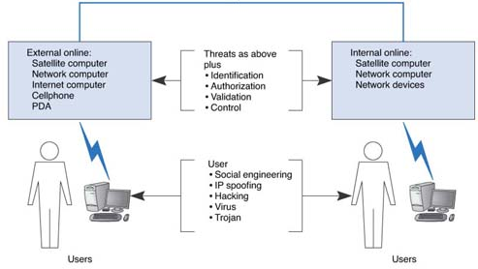
Example of Some Threats (Cont.)
Data Communications for a Global Environment

Slide 9
Security Threats
Data Communications for a Global Environment
Identify threats
Any potentially adverse occurrence that can
Harm or interrupt the systems using the network, or
Cause a monetary loss to an organization
Rank threats according to
Their probability of occurrence
Likely cost if the threat occurs
Take the nature of business into account
Example: Internet banking vs. a restaurant
Bank’s web site: has a higher probability of attack and much bigger loss if happens
Restaurant web site: much less likely and small loss

Slide 10
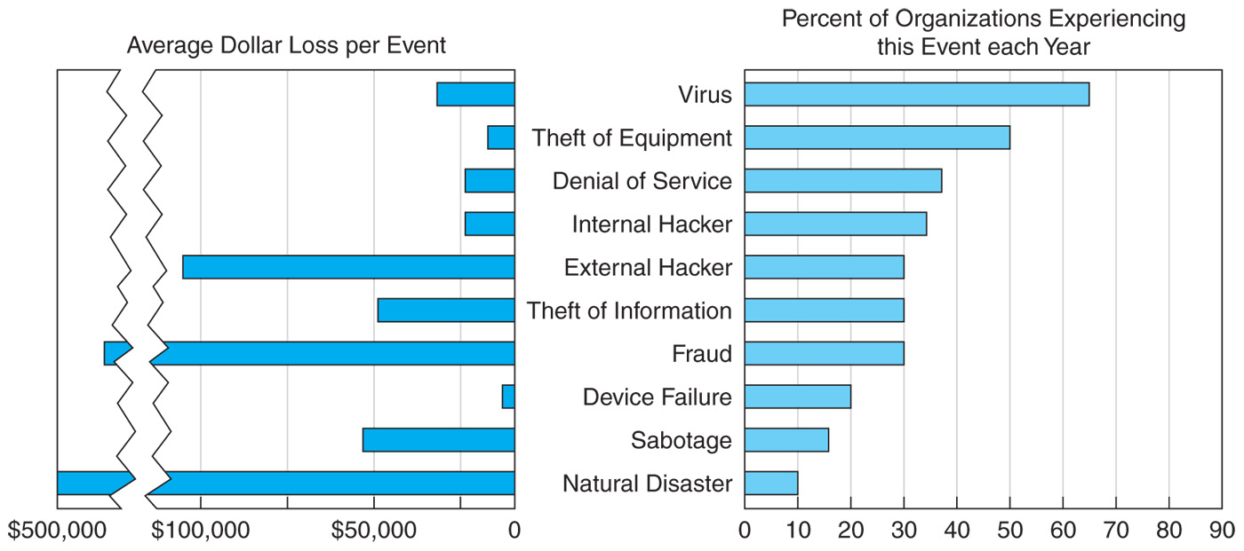
Likelihood and Costs of Threats
Data Communications for a Global Environment

Slide 11
Common Security Threats
Data Communications for a Global Environment
THREATS:
Virus infection is most likely event
Intrusion
By internal employees and external hackers
High cost to recover in terms of financials and publicity
Device failure (not necessarily by a malicious act)
Device theft, Natural Disaster
Denial of Service attacks
External attacks blocking access to the network
Big picture messages:
Viruses: most common threat with a fairly high cost
External intrusion is now greater threat than own employees
COST OF THREATS:
Costs may be $33,000 per virus that infects an average number of computers
External intrusion may cost an average of $100,000 per incident
Internal intrusion happens about as frequently as external intrusion, external is rising
Natural disasters happen to about 20 percent of organizations each year
Denial of Service attacks could cost Amazon.com $10 million per hour, organizations typically lose $100,000 to $200,000 per hour
Cost of lost work for a single LAN may be $1000 to $5000 per hour

Slide 12
Preventing Computer Viruses
Data Communications for a Global Environment
Viruses
spreads when infected files are accessed
Macro viruses attach themselves to other programs (documents) and spread when the programs are executed (the files are opened)
Worms
Special type of virus that spread itself without human intervention (sends copies of itself from computer to computer)
A Trojan Horse
is a subset of a Virus. It does not reproduce by infecting files or does it self replicate. It may open up a backdoor for more malicious attacks.

Slide 13
Preventing Denial of Service Attacks
Data Communications for a Global Environment
DoS attacks
Network disrupted by a flood of messages that prevents messages from normal users
Flooding web servers, email servers so server cannot respond
Distributed DoS (DDoS) come from many different computers
DDoS agents on several machines are controlled by a DDoS handler, may issue instructions to computers to send simultaneous messages to a target computer
Difficult to prevent DoS and DDoS attacks
Setup many servers around the world
Use Intrusion Detection Systems
Require ISPs to verify that all incoming messages have valid IP addresses

Slide 14
DOS and DDOS Approaches
Data Communications for a Global Environment
Traffic filtering: verify all incoming traffic source addresses for validity (requires a lot of processing)
Traffic limiting: When a flood of packets are entering the network, limit incoming access regardless of source (some may be legitimate)
Traffic anomaly detectors: Perform analysis of traffic to see what normal traffic looks like, block abnormal patterns

Slide 15
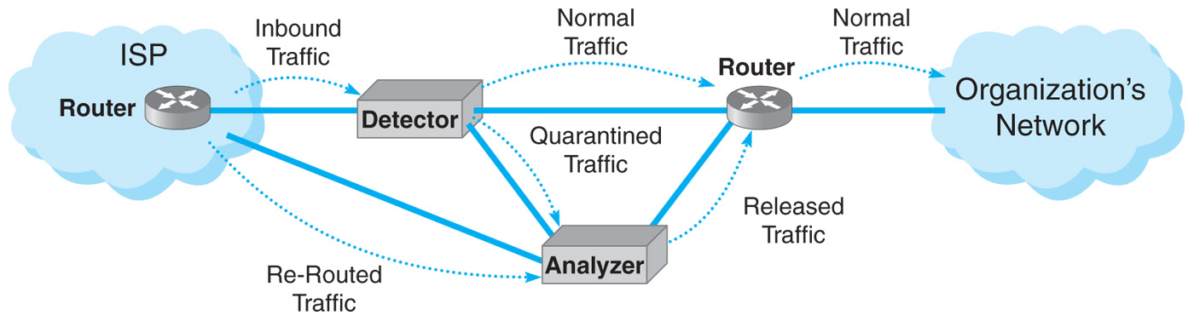
c11f007
Data Communications for a Global Environment
Traffic Analysis

Slide 16
Firewalls
Data Communications for a Global Environment
Prevent intruders by securing Internet connections
From making unauthorized access and denial of service attacks to your network
Could be a router, gateway, or special purpose computer
Examines packets flowing into and out of the organization’s network
Restricts access to that network
Placed on every connection that network has to Internet
Main types of firewalls
Packet level firewalls (a.k.a., packet filters)
Application-level firewalls (a.k.a., application gateway)
NAT Firewalls

Slide 17
Packet-level Firewalls
Data Communications for a Global Environment
Examines the source and destination address of every packet passing through
Allows only packets that have acceptable addresses to pass
Examines IP Addresses and TCP port IDs only
Packet filtering firewall is unaware of applications and what the intruder is trying to do
Access Control Lists
A set of rules for a packet-level firewall
Can be used to
permit packets into a network
deny packets entry

Slide 18
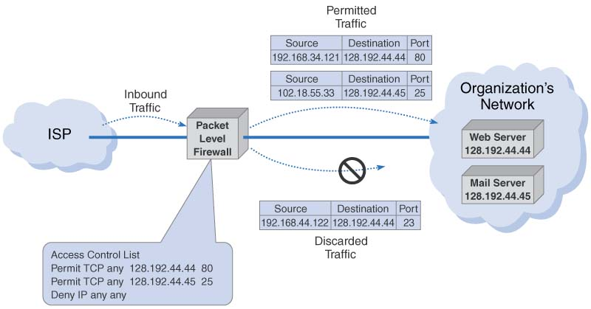
How Packet Level Firewalls Work
Data Communications for a Global Environment

Slide 19
IP Spoofing
Data Communications for a Global Environment
“IP spoofing” remains a problem
Done by simply changing the source address of incoming packets from their real address to an address inside the organization’s network
Firewall will pass this packet as it looks like a valid internal IP address
Many firewalls know to discard incoming packets with internal IP addresses

Slide 20
Application-Level Firewalls
Data Communications for a Global Environment
Acts as an intermediate host computer (between outside clients and internal servers)
Forces anyone to login to this firewall and allows access only to authorized applications (e.g., Web site access)
Separates a private network from the rest of the Internet
Hides individual computers on the network behind the firewall
Some prohibit external users downloading executable files
Software modifications done via physical access
Requires more processing power than packet filters which can impact network performance

Slide 21
Network Address Translation (NAT)
Data Communications for a Global Environment
Used by most firewalls to shield a private network from public network
Translates between private addresses inside a network and public addresses outside the network
Done transparently (unnoticed by external computers)
Internal IP addresses remain hidden
Performed by NAT proxy servers
Uses an address table to do translations
Ex: a computer inside accesses a computer outside
Change source IP address to its own address
Change source port number to a unique number
Used as an index to the original source IP address
Performs reverse operations for response packets

Slide 22
Using Private Addresses with NAT
Data Communications for a Global Environment
Used to provide additional security
Assigns private IP addresses to devices inside the network
Even if they are discovered, no packets with these addresses will be delivered (publicly illegal IP address)
Example: Assigned by ICANN: 128.192.55.xx
Assign to NAT proxy server: 128.192.55.1
Assign to internal computers: 10.3.3.xx
10.x.x.x is reserved for private networks (never used on Internet)
No problem for users as handled by NAT proxy server, but big problem for intruders
Additional benefit is that it gives ability to have more internal IP addresses for an organization

Slide 23
NAT Proxy Servers
Data Communications for a Global Environment
Becoming popular; replacing firewalls
Slow down message transfer
Require at least two separate DNS servers
For use by external users on Internet
For use by internal users (internal DNS server)
Use of combined, layered approach
Use layers of NAT proxy servers, packet filters and application gateways
Maintaining online resources (for public access) in a “DMZ network” between the internal networks and the Internet

Slide 24
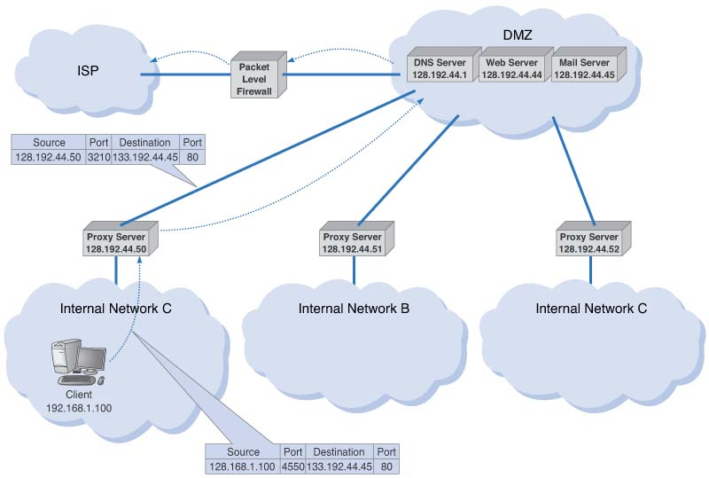
A Network Design Using Firewalls
Data Communications for a Global Environment

Slide 25
Server and Client Protection
Data Communications for a Global Environment
Security Holes
Operating Systems
Trojan Horses
Encryption

Slide 26
Security Holes
Data Communications for a Global Environment
Made by flaws in network software that permit unintended access to the network
A bug that permits unauthorized access
Operating systems often contain security holes
Details can be highly technical
Once discovered, knowledge about the security hole quickly circulated on the Internet
A race can then begin between
Hackers attempting to break into networks through the security hole and
Security teams working to produce a patch to eliminate the security hole
CERT: major clearing house for Internet-related holes

Slide 27
Other Security Holes
Data Communications for a Global Environment
Flawed policies adopted by vendors
New computers come with preinstalled user accounts with well known passwords
Managers forgetting to change these passwords

Slide 28
Operating Systems
Data Communications for a Global Environment
American government's OS security levels
Minimum level (C2): provided by most OSs
Medium Level (B2): provided by some
Highest level (A1 and A2): provided by few
Windows vs. Linux

Slide 29
OS Security: Windows vs. Linux
Data Communications for a Global Environment
Windows
Originally written for one user one computer
User with full control
Applications making changes to critical parts of the system
Advantages: More powerful applications without needing user to understand internals; feature rich, easy to use applications
Disadvantages: Hostile applications taking over the system
Linux
Multi-users with various access rights
Few system administrators with full control

Slide 30
Trojan Horses
Data Communications for a Global Environment
Remote access management consoles (rootkits) that enable users to access a computer and manage it from afar
More often concealed in other software that is downloaded over Internet
Common carriers: Music and video files shared on Internet sites
Undetected by even the best antivirus software
Major Trojans
Back Orifice: attacked Windows servers
Gave the attacker the same right as the administrator
Morphed into tools such as MoSucker and Optix Pro
Powerful and easy to use

Slide 31
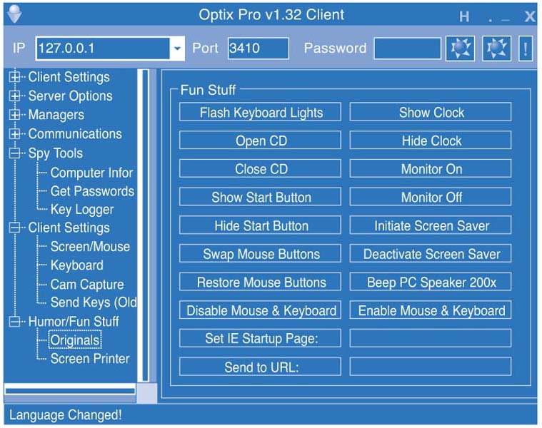
Optix Pro Trojan Menu
Data Communications for a Global Environment

Slide 32
Three Types of Trojans
Data Communications for a Global Environment
Spyware
Monitors what happens on the target computer
Can record keystrokes
Adware
Monitors users’ actions
Displays pop-up advertisements on the screen
DDos

Slide 33
Encryption
Data Communications for a Global Environment
One of the best way to prevent unauthorized access (more formally, cryptography)
Process of disguising info by mathematical rules
Main components of encryption systems
Plaintext: Unencrypted message
Encryption algorithm: Works like the locking mechanism to a safe
Key: Works like the safe’s combination
Cipher text: Produced from the plaintext message by the encryption function
Decryption - the same process in reverse
Doesn’t always use the same key or algorithm.
Plaintext results from decryption

Slide 34
Encryption Techniques
Data Communications for a Global Environment
Symmetric (single key) encryption
Uses the same algorithm and key to both encrypt and decrypt a message
Most common
Asymmetric (public key) encryption
Uses two different “one way” keys:
a public key used to encrypt messages
a private key used to decrypt them
Digital signatures
Based on a variation of public key encryption

Slide 35
Symmetric Encryption
Data Communications for a Global Environment
Key must be distributed
Vulnerable to interception (an important weakness)
Key management – a challenge
Strength of encryption
Length of the secret key
Longer keys more difficult to crack (more combinations to try)
Not necessary to keep the algorithm secret
How to break an encryption
Brute force: try all possible combinations until the correct key is found

Slide 36
Symmetric Encryption Techniques
Data Communications for a Global Environment
Data Encryption Standard (DES)
Developed by the US government and IBM
Standardized and maintained by the National Institute of Standards and Technology (NIST)
A 56-bit version of DES: used commonly, but can be broken by brute force (in a day)
Not recommended for data needing high security
Other symmetric encryption techniques
Triple DES (3DES): DES three times, effectively giving it a 168 bit key
Advanced Encryption Standard (AES), designed to replace DES; uses 128, 192 and 256 bit keys
RC4: a 40 bit key, but can use up to 256 bits

Slide 37
Regulation of Encryptions
Data Communications for a Global Environment
Considered a weapon by the U.S. government
Regulated its export the same way the weapons are
Present rule:
Prohibits the export of encryption techniques with keys longer than 64 bit without permission
Exemptions: Canada, European Union; American companies with foreign offices
Focus of an ongoing policy debate between security agencies and the software industry
Many non-American companies and researchers developing more powerful encryption software

Slide 38
Asymmetric Encryption
Data Communications for a Global Environment
Also known as Public Key Encryption (PKE)
Most popular form of PKE: RSA
Named (1977) after the initials of its inventors: Rivest, Shamir, and Adelman
Forms the basis of Public Key Infrastructure (PKI)
Patent expired in 2000; Now many companies offer it
Longer keys: 512 bits or 1,024 bits
Greatly reduces the key management problem
Publicized Public keys easily accessible in a public directory
Never distributed Private keys (kept secret)
No need to exchange keys
Sender uses the receiver’s public key to encrypt
Receiver uses their private key to decrypt
Public key cannot decrypt public key encrypted message, only private key will work

Slide 39
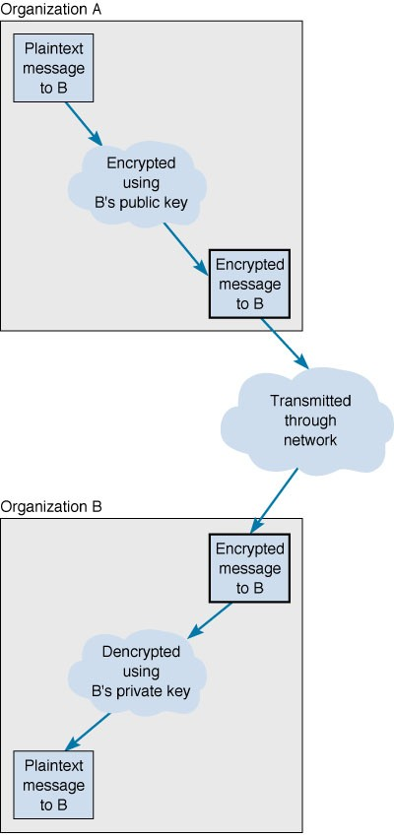
PKE Operations
Data Communications for a Global Environment
2
1
B makes its public key widely available (i.e. through the Internet)
message sender
3
No security hole is created by distributing the public key, since B’s private key has never been distributed.
message recipient

Slide 40
Authentication
Data Communications for a Global Environment
Provide secure and authenticated message transmission, enabled by PKE
Provides a proof identifying the sender
Important for certain legal transactions
Digital Signature:
Includes the name of the sender and other key contents (e.g., date, time, etc.,)
Use of PKE in reverse (applied to Digital Signature part of the message only)
Outgoing: Encrypted using the sender’s private key
Incoming: Decrypted using the sender’s public key
Providing evidence who the message originated from

Slide 41
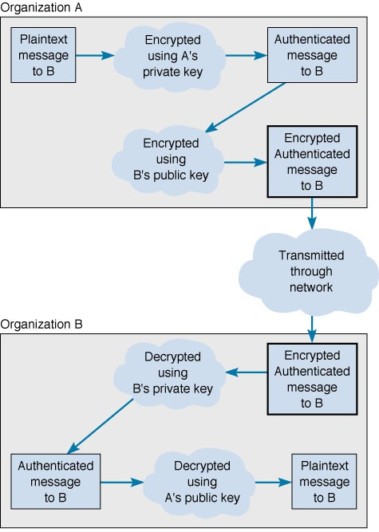
Transmission with Digital Signatures
Data Communications for a Global Environment
Digital Signature only
Organization A
Organization B

Slide 42
Public Key Infrastructure (PKI)
Data Communications for a Global Environment
Set of hardware, software, organizations, and policies to make PKE work on Internet
Solves the problem with digital signatures
How to verify that the person sending the message
Elements of PKI
Certificate Authority (CA)
A trusted organization that can vouch for the authenticity of the person of organization
Certificate
A digital document verifying the identity of a digital signature’s source
“Fingerprint”
A unique key issued by the CA for every message sent by the user (for higher security certification)

Slide 43
Process with Certificate Authority
Data Communications for a Global Environment
User registers with a CA (e.g., VeriSign)
Must provide some proof of Identity
Levels of certification: Examples:
Simple confirmation of an email address
Complete police style background check
CA issues a digital certificate
User attaches the certificate to transactions (email, web, etc)
Receiver authenticates transaction with CA’s public key
Contact CA to ensure the certificate is not revoked or expired

Slide 44
Pretty Good Privacy (PGP)
Data Communications for a Global Environment
A PKE freeware package
Often used to encrypt e-mail
Users make their public keys available
Example: Posting them on Web pages
Anyone wishing to send an encrypted message to that person
Copies the public key from the Web page into the PGP software
Encrypts (via PGP software) and sends the message using that key

Slide 45
Secure Sockets Layer (SSL)
Data Communications for a Global Environment
HTTP, FTP, SMTP
SSL
TCP
IP
Data Link
Physical
A protocol widely used on the Web
Between the application and transport
layers
Operations of SSL
Encrypts outbound packets from application layer before transport layer
Negotiation for PKI
Server sends its public key and encryption
technique to be used (e.g., RC4, DES)
Browser generates a key for this encryption technique; and sends it to the server (by encrypting with server’s public key)
Communications encrypted by using the key generated by browser

Slide 46
IP Security Protocol (IPSec)
Data Communications for a Global Environment
Another widely used encryption protocol
Can be used with other application layer protocols
(not just for web applications)
Operations of IPSec between A and B
A and B generate and exchange two random keys using Internet Key Exchange (IKE)
Then combine these two numbers to create encryption key to be used between A and B
Next, A and B negotiate the encryption technique to be
used, such as DES or 3DES.
A and B then begin transmitting data using either:
Transport mode: only the IP payload is encrypted
Tunnel mode: entire IP packet is encrypted (needs a new header for routing in Internet
HTTP, FTP, SMTP
TCP, UDP
IPSec
IP
Data Link
Physical

Slide 47
Techniques Used by IPSs
Data Communications for a Global Environment
Misuse detection
Compares monitored activities with signatures of known attacks
If an attack is recognized the IPS issues an alert and discards the packet
Challenge: keep database current
Anomaly detection
Operates in stable computing environments
Looks for major deviations from the “normal” parameters of network operation
e.g., a large number of failed logins
When detected, an alert is issued, packets discarded
Problem: false alarms (valid traffic different from normal)

Slide 48
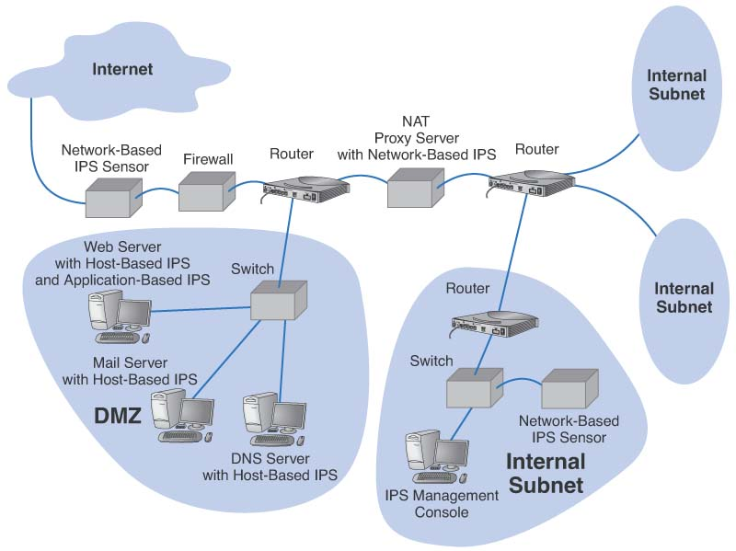
Use of IPS with Firewalls
Data Communications for a Global Environment

Slide 49
Intrusion Recovery
Data Communications for a Global Environment
Must have a clear plan to respond to breaches
Have an emergency response team (CERT for Internet)
Steps to take once intrusion detected:
Identify where the security breach occurred and how it happened
Helps to prevents other doing it the same way
May report the problem to police
Use Computer Forensics area techniques
Use of computer analysis techniques to gather evidence for trials
Entrapments – Use of honey pots
Divert attackers to a fake server (with interesting, but fake data used as bait)
Monitor access to this server; use it as a proof

